Slide 1

Computer Science Special Project
by
Tsai-Yen Li
(李蔡彥)
Computer Science Department
National Chengchi University
Second Semester, 2011

Slide 2
Introduction
Motivations and applications
Categories of motion planning algorithms
cell decomposition methods (Approximate/Exact)
Roadmap methods
Potential field methods
Workspace and C-space concepts
Computing C-obstacle regions: Minkowski Sums
Planning for low-dimensional C-space
Planning for high-dimensional C-space

Slide 3
Position of the Field: Motion Planning
Computer Graphics
Robotics
Computational Geometry
Artificial Intelligent

Slide 4
Motivations and Applications
To design autonomous robots
performs actions without being told how
Robot must be able to plan its motion
has a map of the environment
Applications:
Robotics (robot arms/mobile robots)
CAD/CAM (maintainability study, assembly)
Pipe routing 管線設計
Drug design (Molecular computation)
藥物設計(分子計算)
Graphics (Virtual Environments)
Notes:
自動化機器人

Slide 5
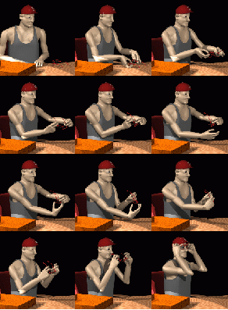


Application: Movie Generation
Notes:
左圖: 1994 電腦自動產生動畫

Slide 6
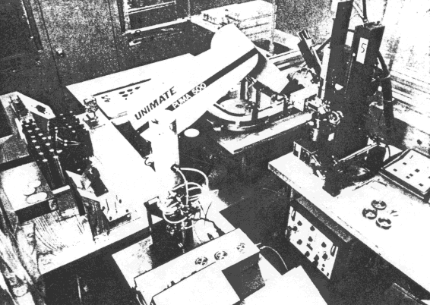
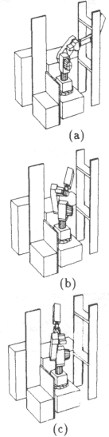
Applications: Automatic Robot Programming
Notes:
工廠中機械手臂自動規劃路線
更加客製化，不須由人修改

Slide 7
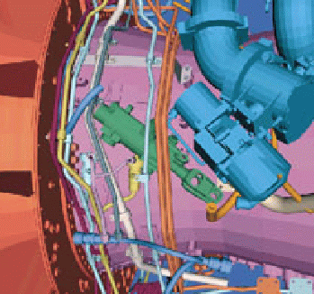
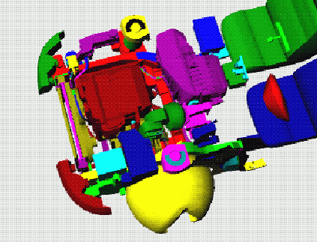
Applications: Maintenance Planning
Notes:
汽車、飛機維護：零件拿出來的路徑

Slide 8
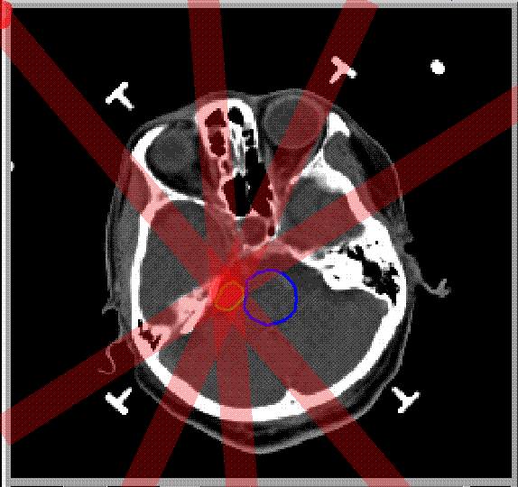
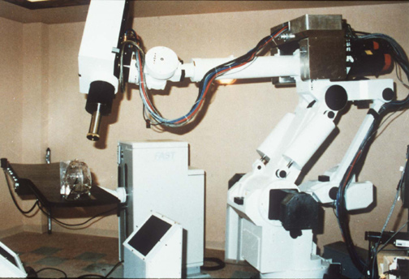
Applications: Radiosurgery of the Brain
Notes:
放射性治療 規劃射線路徑

Slide 9
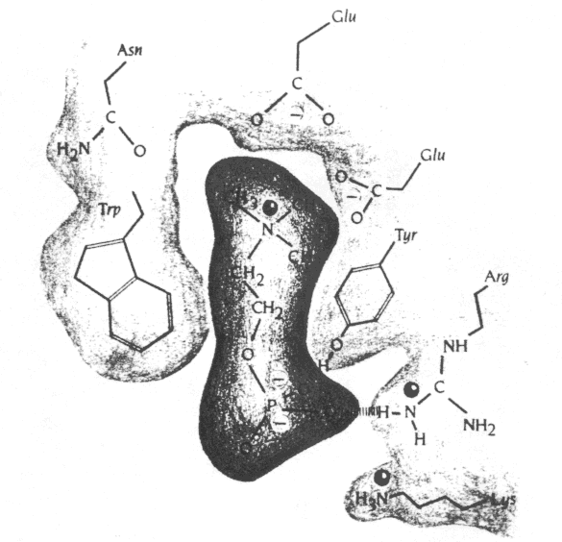
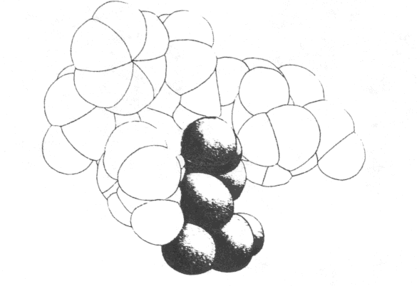
Applications: Generation of Plausible Docking Motions
Notes:
製藥 病毒結構對人體產生傷害，設計出蛋白質結構來中和

Slide 10
The General Path Planning Problem
Environment may vary over time
Other robots may exist in the environment.
coordinated motion problems
There may be constraints on the motion.
E.g. Minimum turning radius
E.g. Maximum displacement of a prismatic joint
There may be a cost function to minimize or maximize.
time, distance, energy, safety
The robot can have many degrees of freedom (DOF)
translation, rotation, joints (revolute, prismatic)
Notes:
定義問題：
環境變動
合作協調
運動模式限制
最佳化條件
機械自由度(用幾個參數定義一個物件)-> 人真正可以規劃的東西

Slide 11
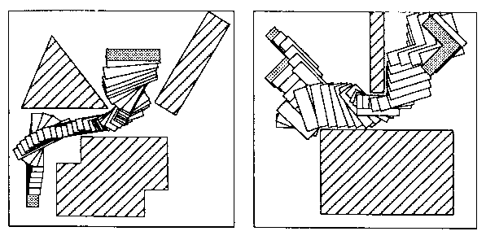
An Example with Few DOF
robot, R
robot, R
obstacle, B
obstacle, B

Slide 12
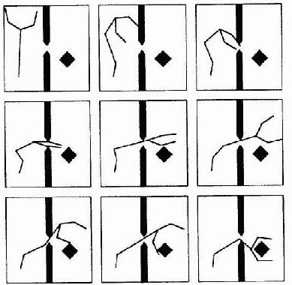
An Example with Many DOF

Slide 13
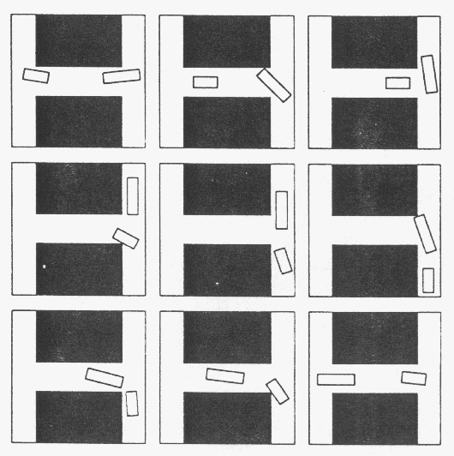
An Example: Coordination of Multiple Robots
Notes:
六維 複雜度指數成長

Slide 14
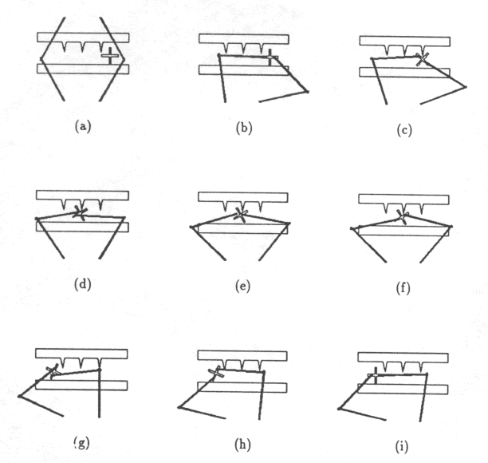
An Example: Manipulation Planning

Slide 15
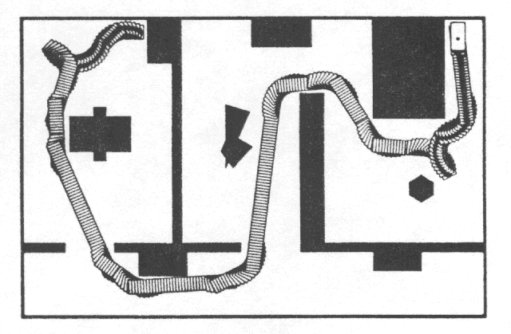
An Example: Nonholonomic Planning for Car-Like Robot
Notes:
有迴轉半徑限制
Nonholonomic 不完整的

Slide 16
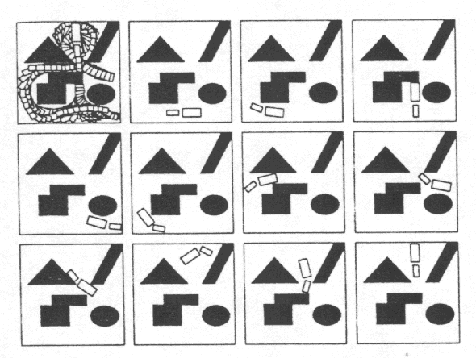
An Example: Tractor-Trailor

Slide 17
Defining a Simplified Problem
Simplifications:
Environment does not vary over time
Single robot in the environment
No constraints on the allowed motion
No cost function
Polygonal obstacles and robot
Allowed to touch obstacles: enlarging the robot for safety margin
Input
polygonal floor plan in 2D containing obstacles
polygonal robot with initial and goal configurations
Output
a path from initial to goal which does not cause the robot to collide with the obstacles if one exists; otherwise, report that fact.

Slide 18
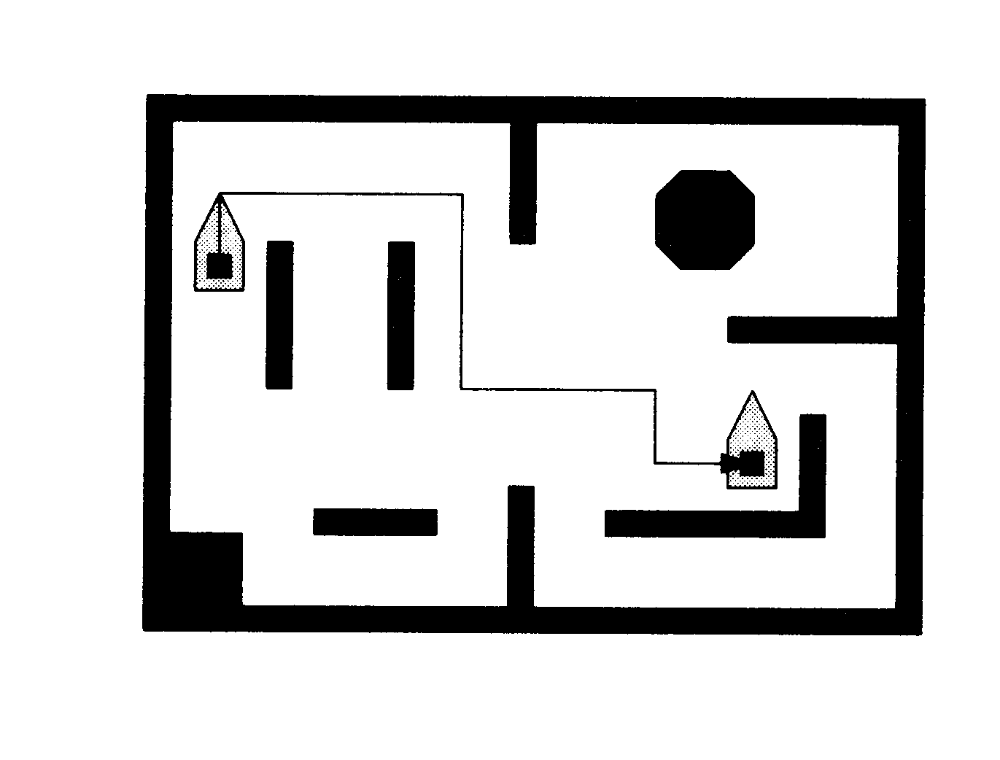
A Sample Problem

Slide 19
General Principle
Two steps:
Preprocessing: Capture free space connectivity into a graph or a function.
Query processing:Search a graph for a path.
Three families of methods:
Cell decomposition
Roadmap
Potential Field

Slide 20
Planning Methods Overview: Cell Decomposition
Cell: Connected region of free space, such that computing a path between any two points in the same cell is straightforward.
Example: convex polygon.
Preprocessing:
Represent the free space as a collection of cells.
Generating the connectivity graph representing the adjacency relation between cells
Query pressing:
Search the connectivity graph: for a sequence of adjacent cells connecting the initial and goal cell.
Transform the sequence of cells into a path.
Notes:
切割free space->cell 以凸多邊形最好：任兩點連接都在多邊形裡面->不會碰到障礙物

Slide 21
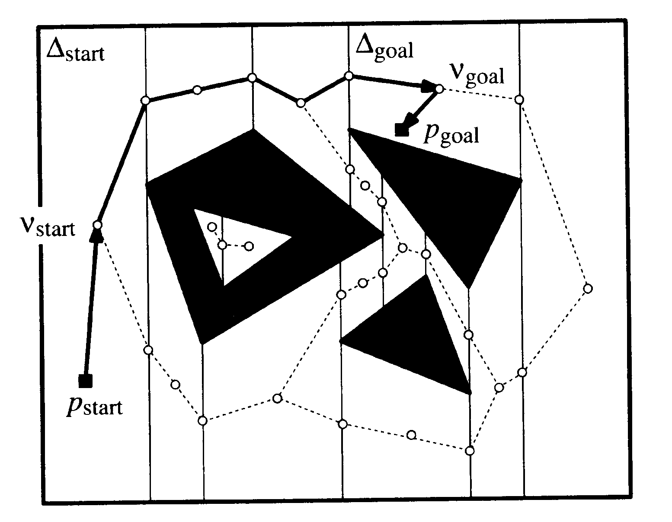
Exact Cell Decomposition
Notes:
切直線 碰到障礙物頂點 一定會切出梯形(必為凸多邊形)

Slide 22
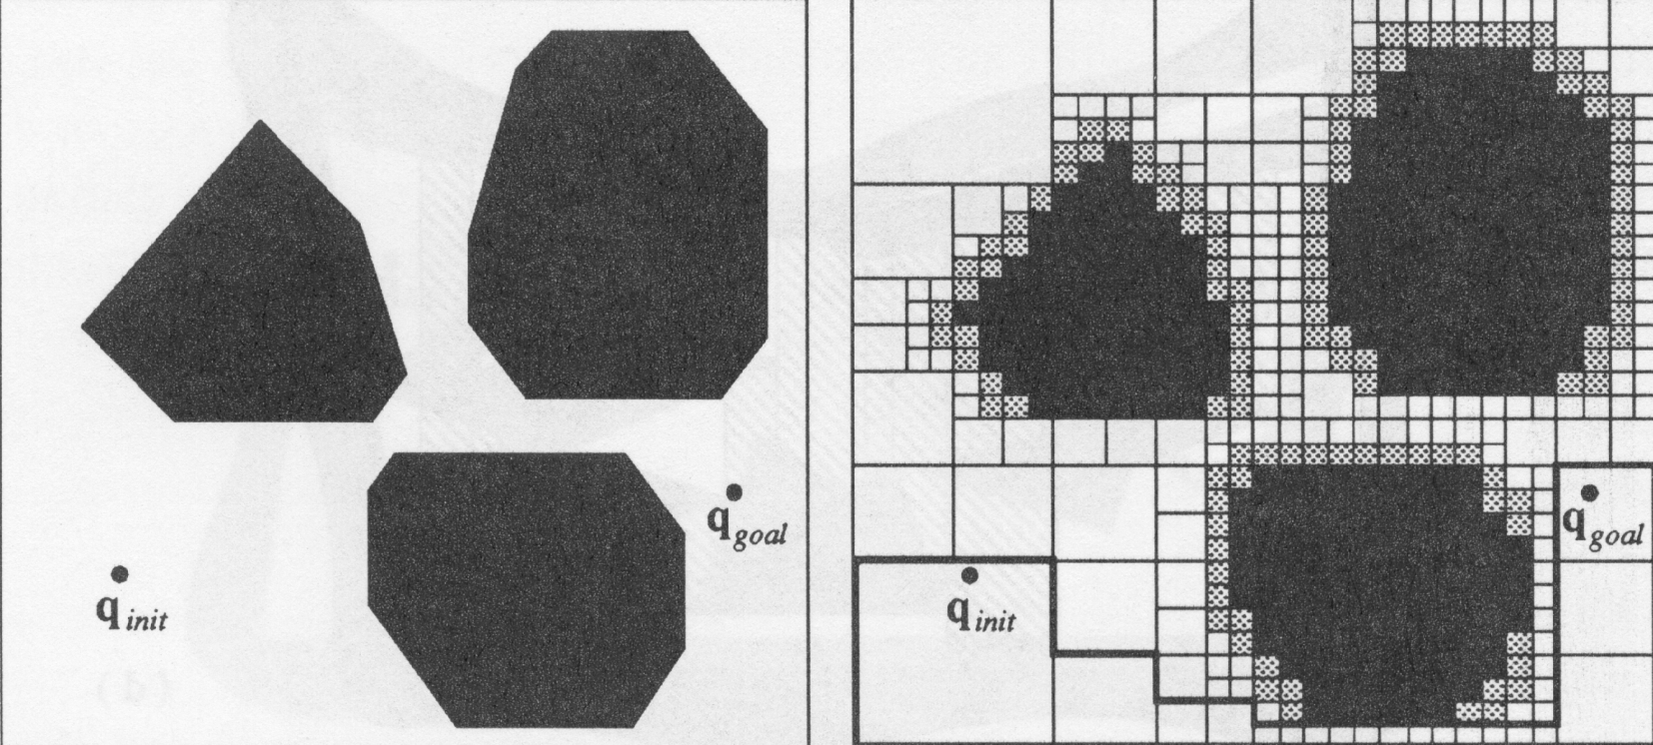
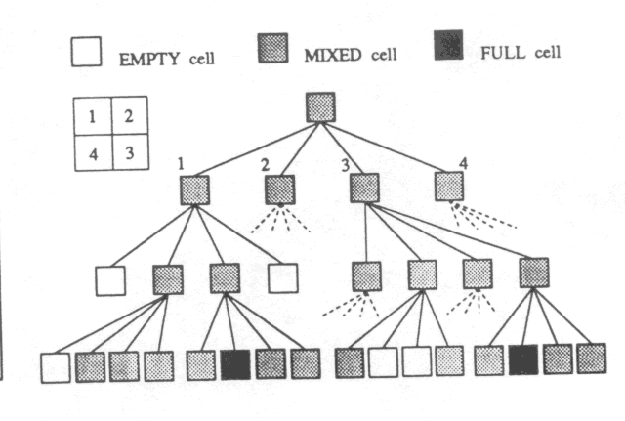
Approximate Cell Decomposition: 2D Quadtree
Notes:
還沒黑白分明之前不斷地切割
灰色:要繼續切割

Slide 23
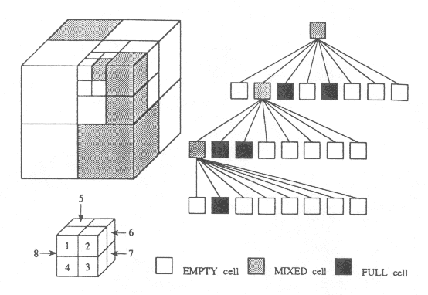
Approximate Cell Decomposition 3D OcTree
Notes:
八分樹

Slide 24
Planning Methods Overview: Roadmap Methods
Preprocessing:
Construct a network of curves (the roadmap) that “adequately”represents the connectivity of the free space.
Query processing:
Connect the initial and goal position of the robot to the roadmap.
Search the resulting graph for a path between the initial and goal positions of the robot.
Notes:
街圖法
把平面濃縮到曲線 代表一個free space
也是graph

Slide 25
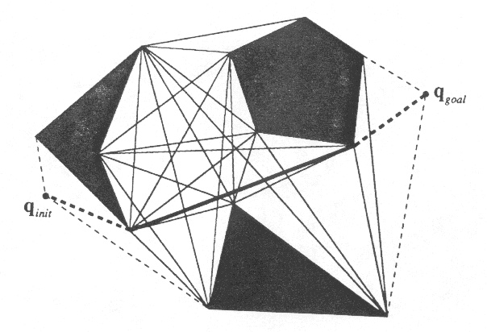
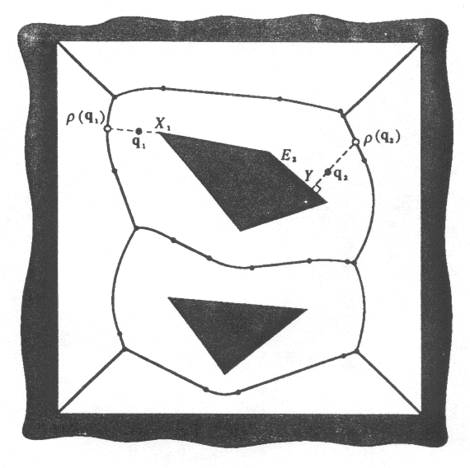
Roadmap Methods
Visibility Graph
Voronoi Diagram
Notes:
Visibility Graph: 所有頂點連起來，找出所有可能，可找最短路徑 缺點：只能用2D不能3D
Voronoi Diagram: 兩邊界之間等距的中線結合

Slide 26
Planning Methods Overview: Potential Field Methods
Preprocessing:
Construct an artificial potential field in the workspace.
Goal configuration has a unique global zero potential.
Query processing:
Search the C-space from the initial configuration to the goal configuration by using the potential field as an heuristic(經驗法則).
Notes:
建構人工位能場 有效往低處走
Heuristic 像經驗法則，有可能會判斷錯誤

Slide 27
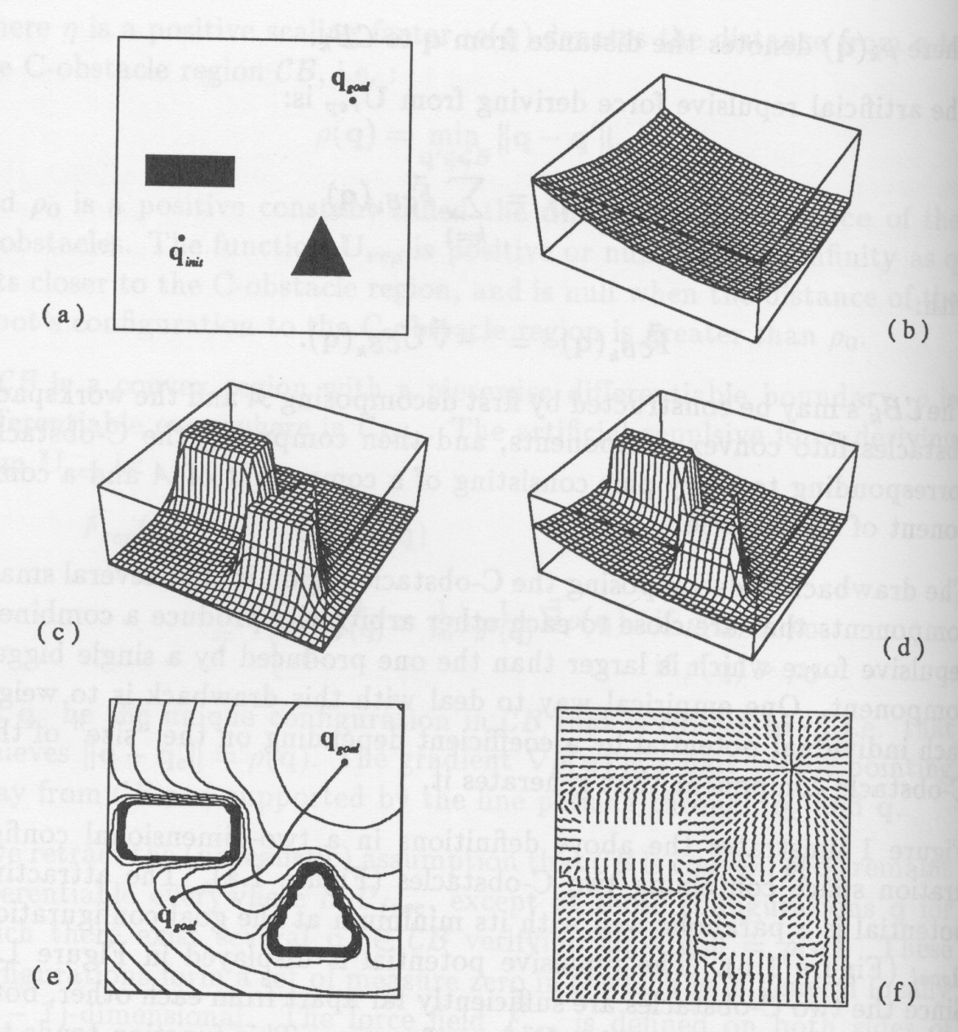
Different Types of Potential Fields
Notes:
吸引/排斥的位能場

Slide 28
Example of Analytical Definition
Notes:
吸引：成正比
排斥：成反比

Slide 29
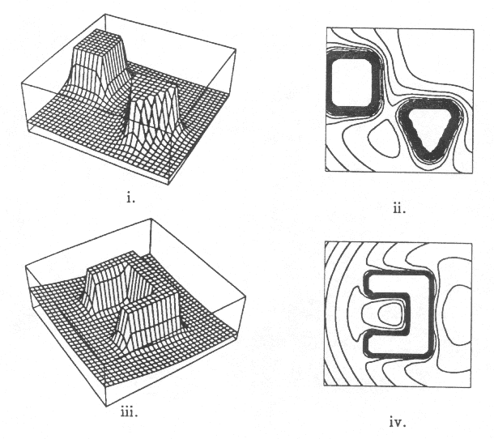
Local Minima in a Potential Field
Example of Local Minima
Notes:
下面的例子有問題
吸引到凹槽裡之後會不知道去哪
靠近區域最低點但並非全域最低點

Slide 30
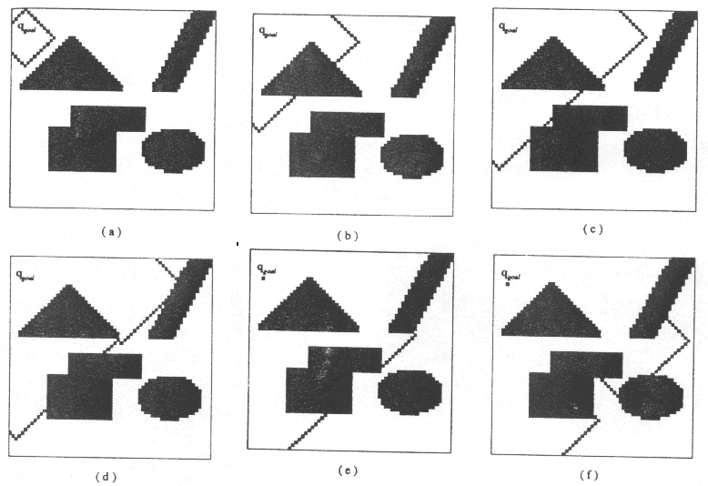
Local-Minima-Free Potential (NF1)

Slide 31
The NF1 Algorithm
procedure NF1;
begin
for every q in GC_{free} do U(q) ← M; [M is a large number]
U(q_{goal}) ← 0; insert q_{goal} in L₀;
[L_{i}, i=0, 1, …, is a list of configurations; it is initially empty]
for i=0, 1, …, until L_{i} is empty do
for every q in L_{i} do
for every 1-neighbor q’ of q in GC_{free} do
if U(q’) =M then
begin
U(q’) ← i+1
insert q’ at the end of L_{i+1}
end;
end;

Slide 32
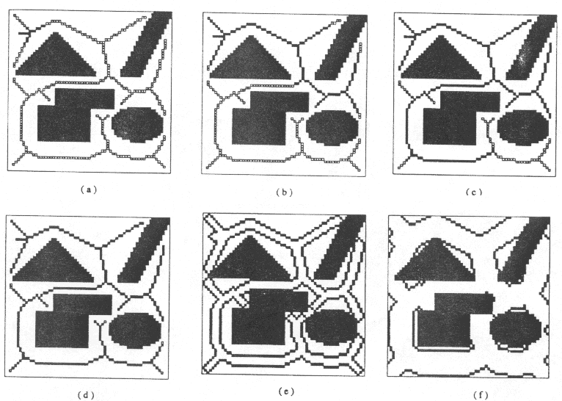
Local-Minima-Free Potential (NF2)

Slide 33
Computing the Distance Map for NF2 Potential Fields
procedure L1;
begin
for every q in GC_{free} do U(q) ← M; [M is a large number]
[L_{i}, i=0, 1, …, is a list of configurations; it is initially empty]
for every q in GC\ GC_{free} do
if there exists a 1-neighbor q’ of q in GC_{free} then
d₁(q) ← 0;
insert q at the end of L₀;
for i=0, 1, …, until L_{i} is empty do
for every q in L_{i} do
for every 1-neighbor q’ of q in GC_{free} do
if d₁(q’) = M then
d₁(q’) ← i+1;
insert q’ at the end of L_{i+1};
end;

Slide 34
Computing the Skeleton for NF2 Potential Fields
procedure SKELETON;
begin
for every q in GC_{free} do U(q) ← M; [M is a large number]
for every q in GC\ GC_{free} do
if there exists a 1-neighbor q’ of q in GC_{free} then
d₁(q) ← 0; O(q)=q; [O is the origin of q]
insert q at the end of L₀;
for i=0, 1, …, until L_{i} is empty do
for every q in L_{i} do
for every 1-neighbor q’ of q in GC_{free} do
if d₁(q’) = M then
d₁(q’) ← i+1; O(q’) ← O(q)
insert q’ at the end of L_{i+1};
else if d₁(O(q’), O(q)) > α then
if (q not in S) then insert q’ in S;
end;

Slide 35
The NF2 Algorithm (I)
procedure NF2;
begin
for every q in GC_{free} do U(q) ← M; [M is a large number]
insert q_{goal} in σ; q ← q_{goal} ;
while q not in S do
select a neighbor q’ having the largest value of d₁;
insert q’ in S; q ← q’;
S ← σ∪S;
U(q_{goal} ) ← 0; INSERT(q_{goal} , Q);
while ┐EMPTY(Q) do
q ← FIRST(Q);
insert q at the end of L₀;
for every m-neighbors q’ of q in S do
if U(q’)=M then
U(q’) ← U(q)+1;
INSERT(q’, Q);

Slide 36
The NF2 Algorithm (II)
[at the end of this loop, L₀ contains all the configurations in S accessible from q_{goal} ]
[the following instructions compute U in the rest of the subset of GC_{free} accessible from q_{goal} ]
for i=0, 1,…until L_{i} is empty do
for every q in L_{i} do
for every neighbor q’ of q in GC_{free} do
if U(q’) = M then
begin
U(q’) ← U(q) +1
insert q’ at the end of L_{i+1};
end;
end;

Slide 37
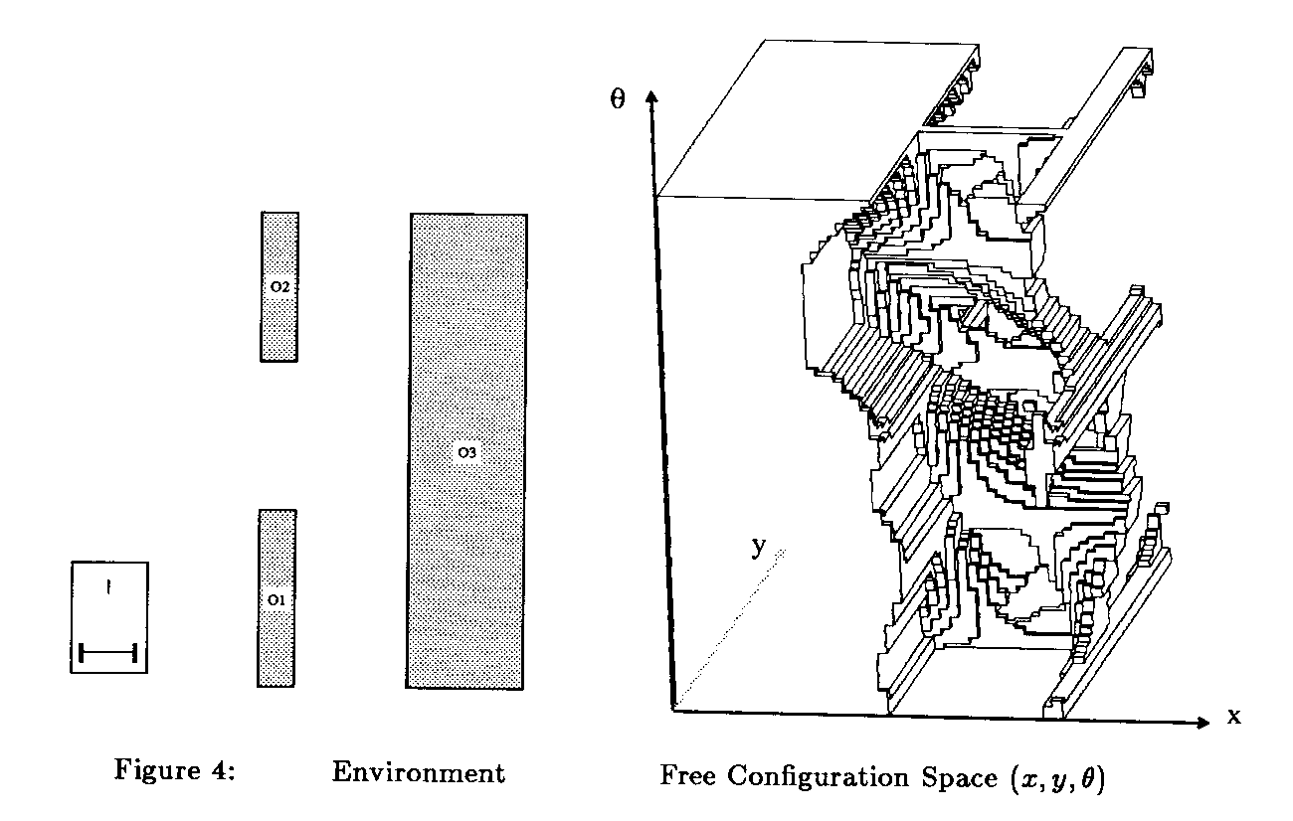
Workspace and Configuration Space
Work Space (WS, W): the space of the original problem (the real world)
Configuration Space (C-space, C): is the parameter space of the problem (more abstract)
W
C
B
A

Slide 38
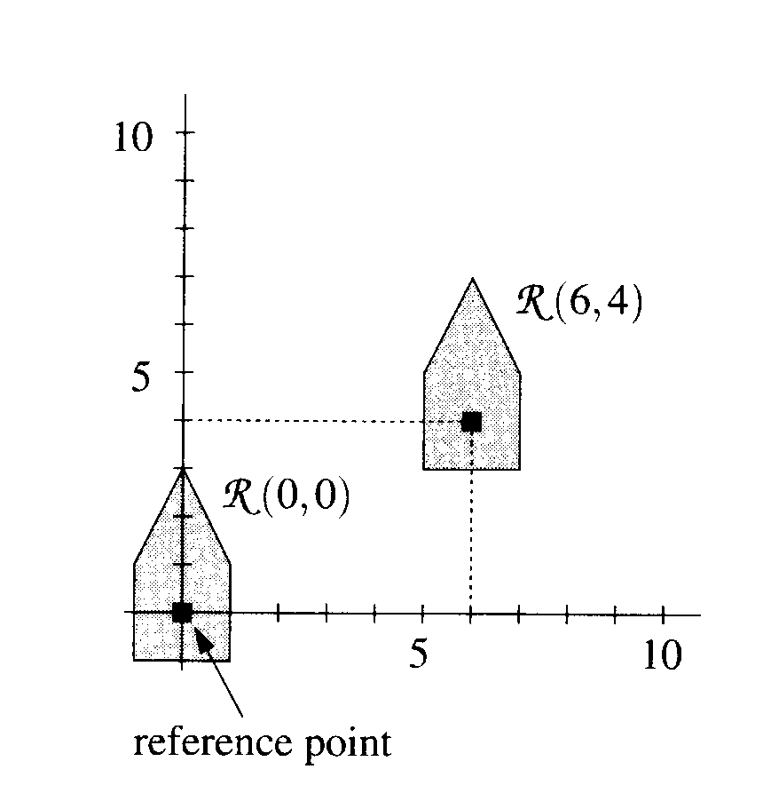
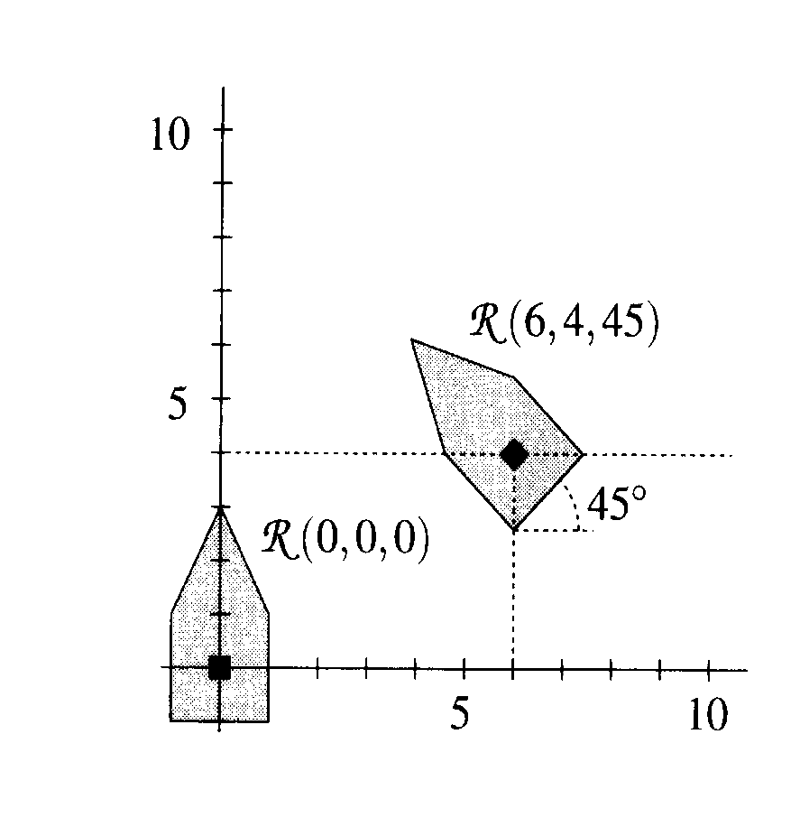
Reference Point on a Robot
Translation only (2DOF)
Rotation as well (3DOF)
Translating and rotating in 3-space (x, y, z, α, β, γ)
Articulated robot: (q₁, q₂)
Notes:
每兩軸有一個角度 2+c22
3+c32

Slide 39
Some Definitions and Notations
Region of W occupied by A when at q: A(q)
Forbidden space (C_{forb}): the set of all points in C such that the corresponding robot placements in W intersect with at least one of the obstacles
Free space (C_{free}): C_{free}=C/ C_{forb}
Path: a curve through C moving continuously from one set of parameter values to another
Collision-free Path: a path wholly contained in C_{free}.

Slide 40
Obstacle Region in C-Space
Obstacles in W map to forbidden regions (C-obstacles) in C-space:
CB={q|A(q)∩B≠0}
Example:
Path planning for a dimensioned robot is reduced to path planning for a point in a different space.
CB
A
Notes:
Cb七邊=機器人3邊+障礙物4邊
所有邊唯一排列而成
C Space把形狀簡化成點(configuration

Slide 41
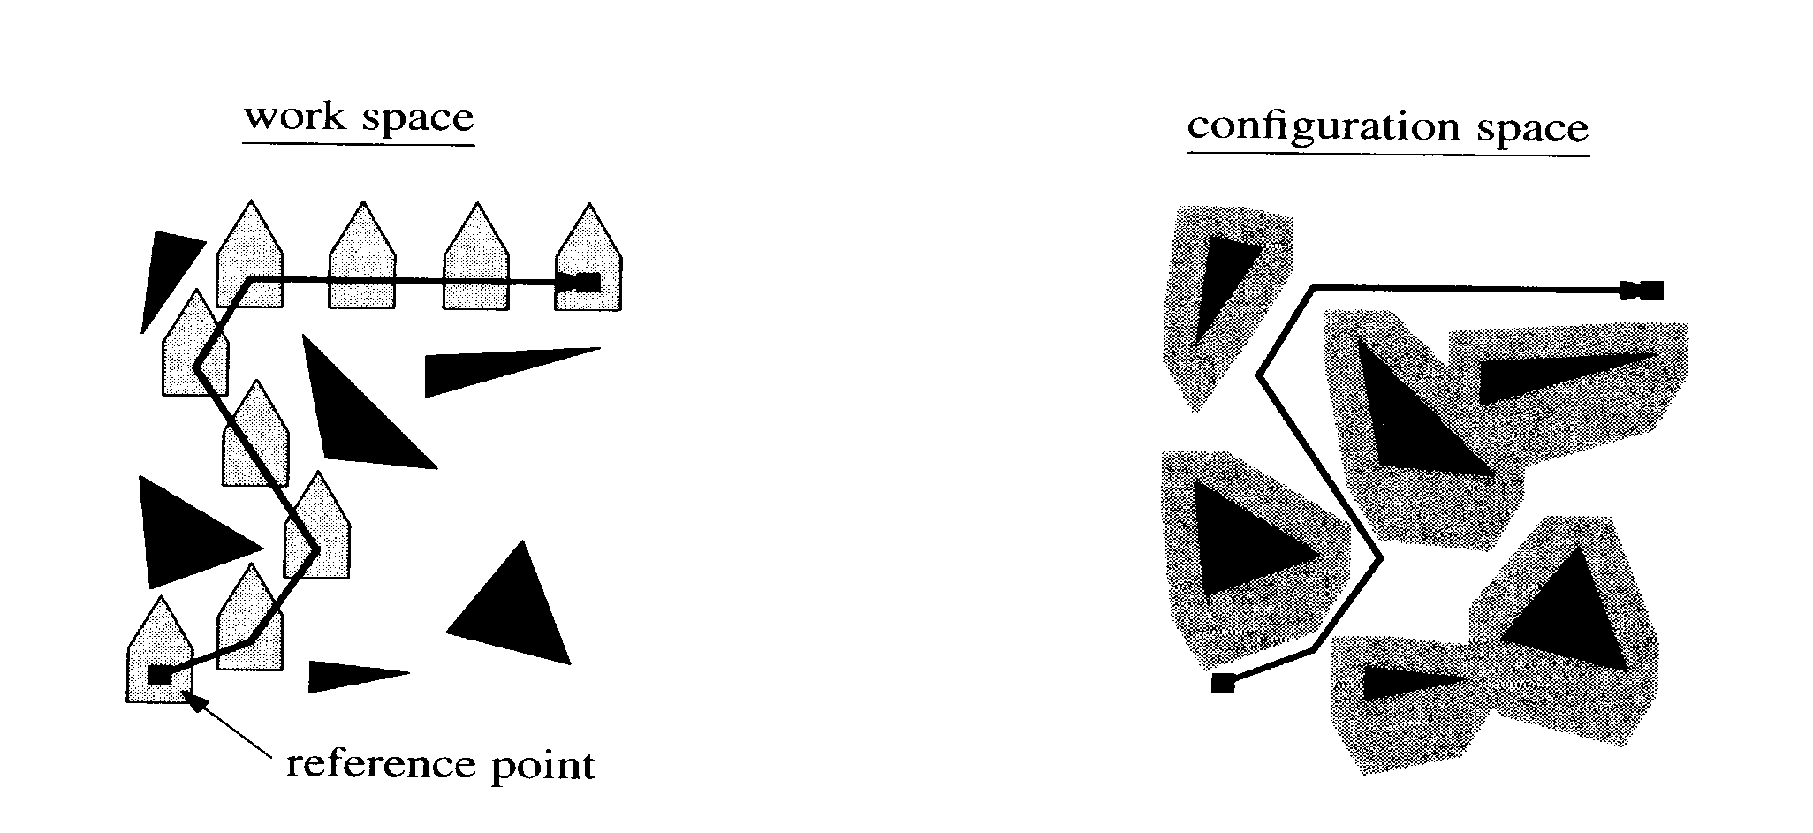
Example of C-Space Obstacles

Slide 42
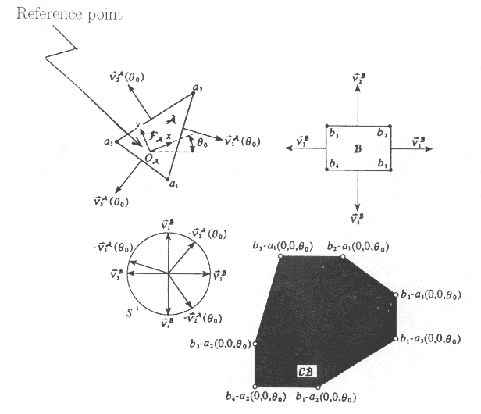
C-obstacle Region for Rigid Robot Translating in a Plane
v₁^{B}
v₂^{B}
v₃^{B}
v₄^{B}
v₁^{A}
v₂^{A}
v₃^{A}
Notes:
B-a後面ㄉ向量往前走

Slide 43
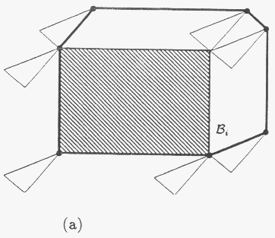
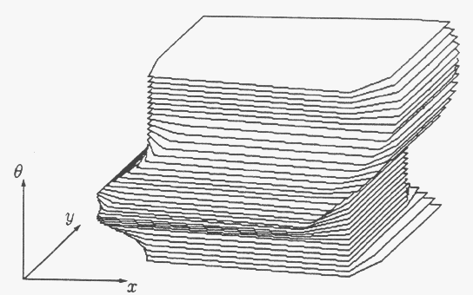
C-Obstacle for Rigid Robot Translating and Rotating in a Plane
Compute a slice for each given θ.

Slide 44
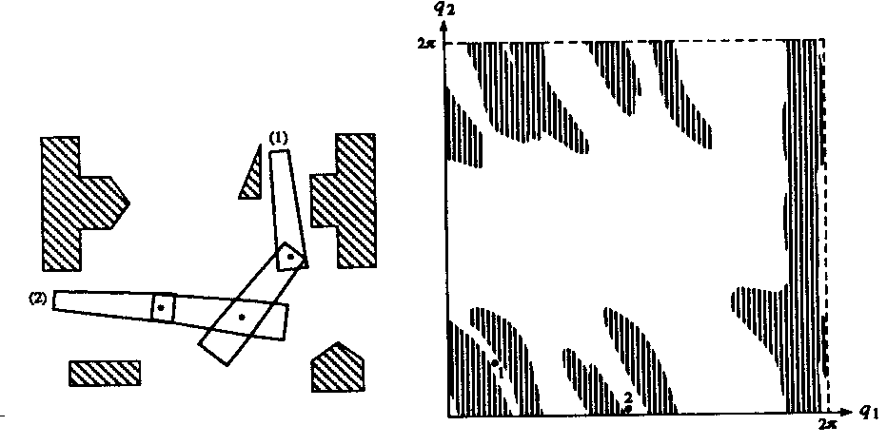
C-obstacle Regions for Articulated Robot
Notes:
多關節(多維)ㄉ不實用 太複雜

Slide 45
Design Guidelines
Previous observations suggest:
The design of efficient complete planners for few degrees of freedom.
The design of planners trades a limited amount of completeness for a major gain in computational efficiency.
Example of weaker completeness: probabilistic completeness, resolution completeness.
The design of heuristic, possibly incomplete, but practically efficient planners.
Notes:
Heuristic 經驗法則
我不知道要打什麼大大家都打我也打一下

Slide 46
Artificial Potential Fields
Computing local-minima-free potentials in C-spaces having more than 3 or 4 dimensions is very time-consuming and impractical.
Use heuristic for generating PF with few and/or small local minima.
Precomputation:
Select s control point p_{i} in A.
For every point p_{i} compute a local-minimum-free potential V_{i}(x) over the workspace, with a global minimum at p_{i}(q_{goal}).
During search: compute arbitration function G:
U(q) = G(V₁(p₁(q), …, V_{s}( p_{s}(q)))
Notes:
不做C space(因為要加角度多一參數=一維)
我真ㄉ忘光 完蛋

Slide 47
Examples of Arbitration Functions
U(q) = V₁(p₁(q))+0.1 V₂(p₂(q))
U(q) = V(p(q))
U(q) = max{V₁(p₁(q)), V₂(p₂(q))}
p₁
p₂
p
Notes:
隨便函式
就靠經驗 都可都可
1>local minimum
3>棍子撞門

Slide 48
Best-First Search Algorithm
procedure BFP;
install x_{init} in T; [initially, T is the empty tree]
INSERT(x_{init}, OPEN); mark x_{init} visited;
[initially, all the points in the grid are marked “unvisited”]
SUCCESS ← false;
while ┐ EMPTY(OPEN) and ┐SUCCESS do
x ← FIRST(OPEN);
for every neighbor x’ of x in the grid do
if U(x’) < M and x’ is not visited then
install x’ in T with a pointer toward x;
INSERT(x’, OPEN); mark x’ visited;
if x’ = x_{goal} then SUCCESS ← true;
if SUCCESS then
return the constructed path by tracing the pointers in T from x_{goal} back to x_{init}
else return failure;
Notes:
OPEN 往外探索ㄉ邊界
U(x’) < M 沒有碰撞

Slide 49
Randomized Path Planning with Potential Fields for High DOF
procedure RPP;
τ ← BEST-FIRST-PATH(q_{init}); q_{loc} ← LAST(τ);
while q_{loc} ≠ qgoaldo
ESCAPE ← false;
for i = 0 to K until ESCAPE do
t ← RANDOM-TIME;
τ_{i} ← RANDOM-PATH(q_{loc} , t); q_{rand} ← LAST(τ_{i} );
τ_{i} ← PRODUCT(τ_{i}, BEST-FIRST-PATH(q_{rand}));
q_{loc}’ ← LAST(τ_{i} );
if U(q_{loc}’ ) < U(q_{loc} ) then
ESCAPE ← true;
τ ← PRODUCT(τ, τ_{i} );
if ┐ESCAPE then
τ ← BACKTRACK(τ, τ₁, …, τ_{k});
q_{back}← LAST(τ);
τ ← PRODUCT(τ, BEST-FIRST-PATH(qback));
q_{loc} =LAST(τ);
Notes:
for裡面一直試
如果一直失敗出不來Backtrack 隨機再選一個點回去

